Slide 1
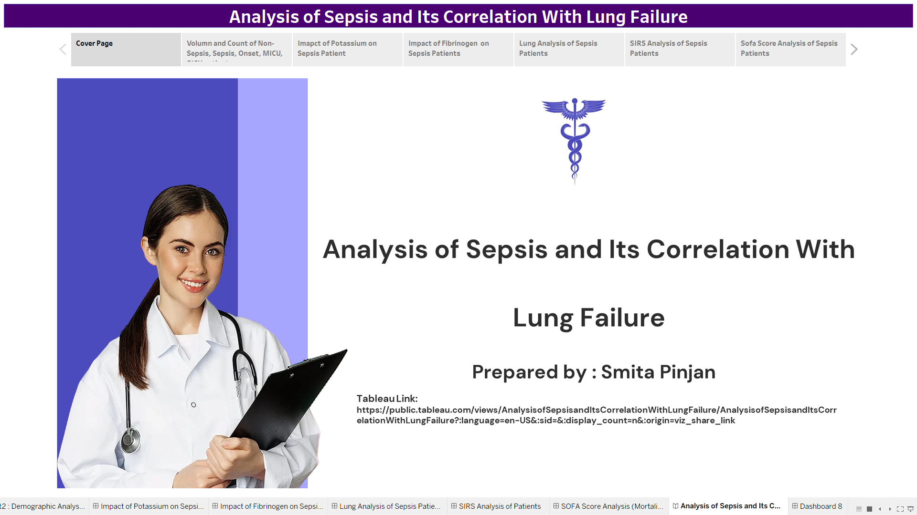
Tableau Link : Analysis of Sepsis and Its Correlation With Lung Failure | Tableau Public

Slide 2
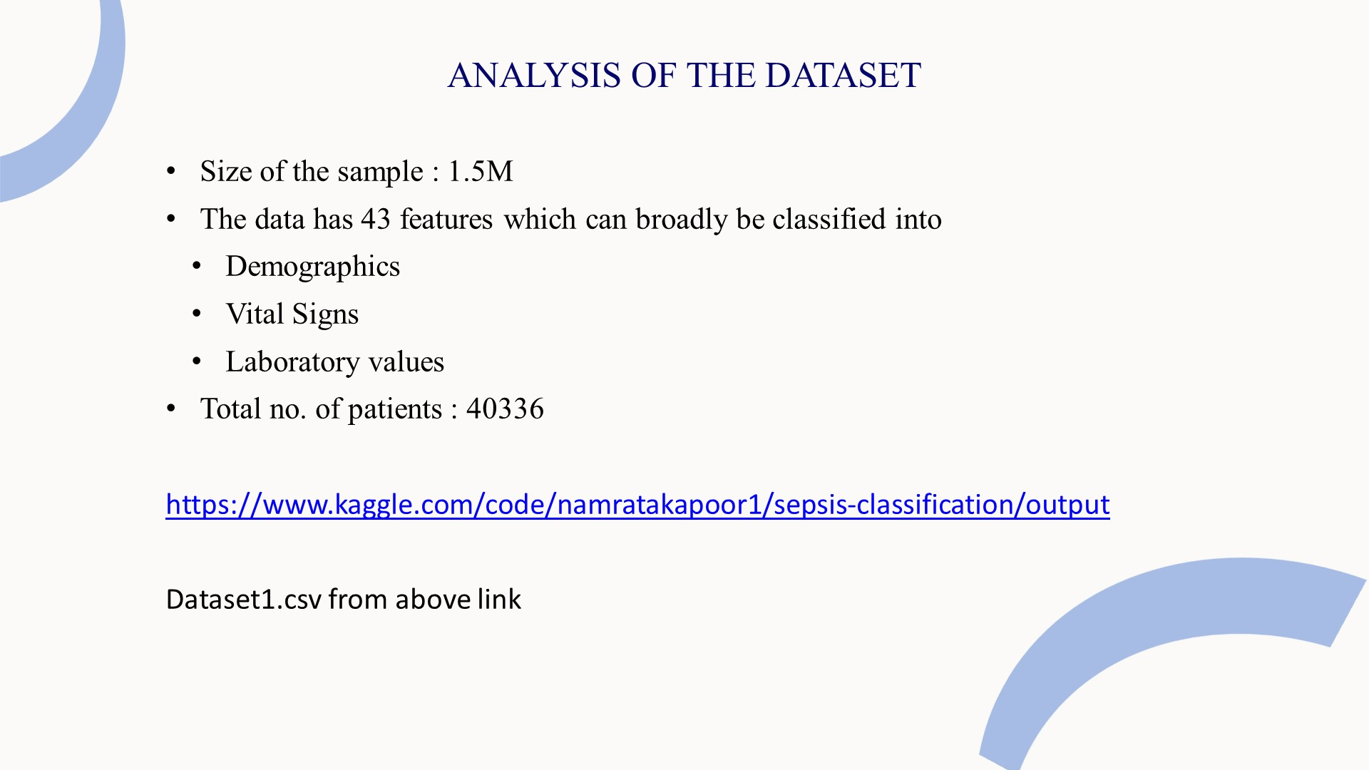
PROBLEM STATEMENT:
Sepsis is a serious medical condition caused by the body’s improper response to an infection which leads to damage to its vital organs and may lead to death. Due to their critical conditions, patients admitted to the ICU are more prone to be diagnosed with Sepsis Infection. Therefore, early detection of Sepsis signs will help to curb the infection and save patients by initiating proper and in-time treatment.
Through this project, I am attempting to create a dashboard that can alert the healthcare team about possible signs of Sepsis which can lead to Lung Failure. So the healthcare providers take immediate action.

Slide 3
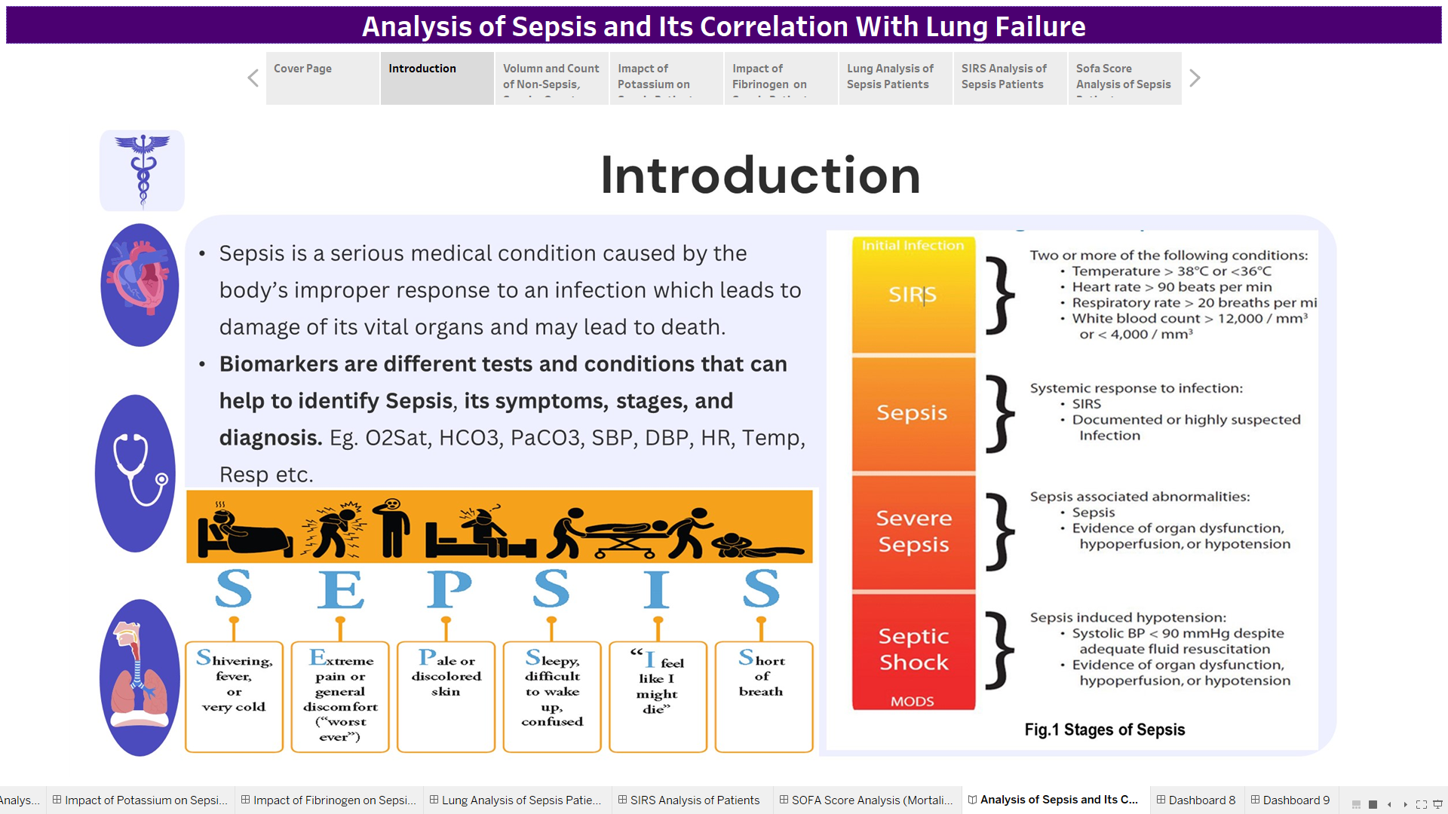

Slide 4
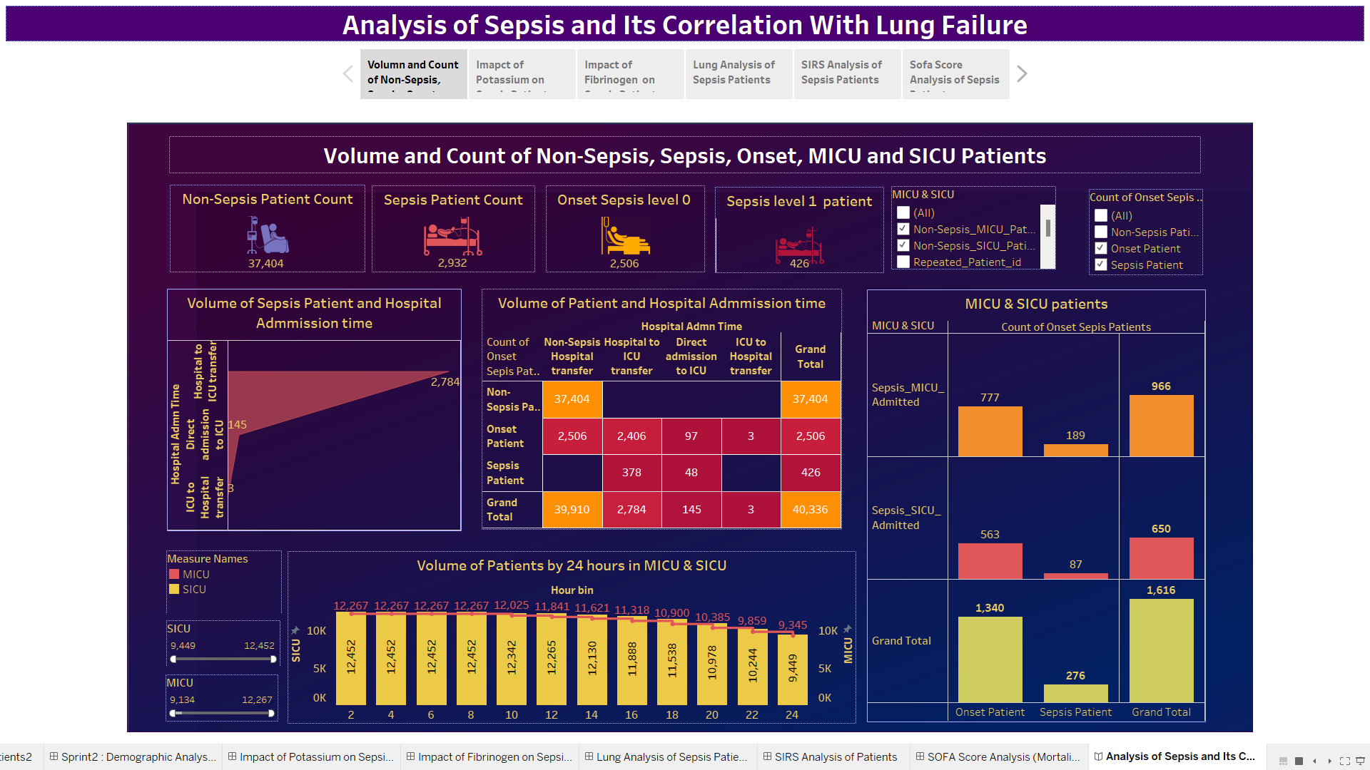

Slide 5
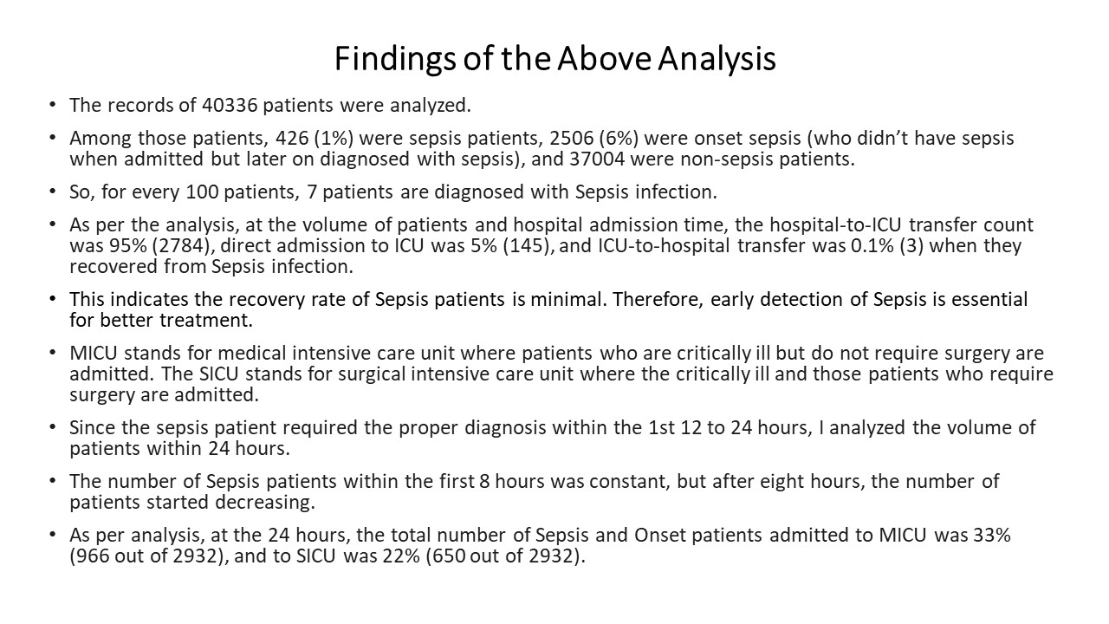

Slide 6
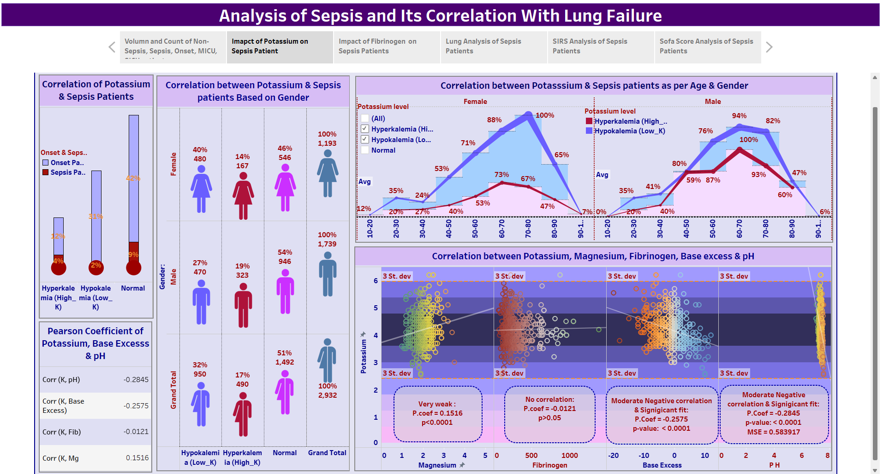

Slide 7
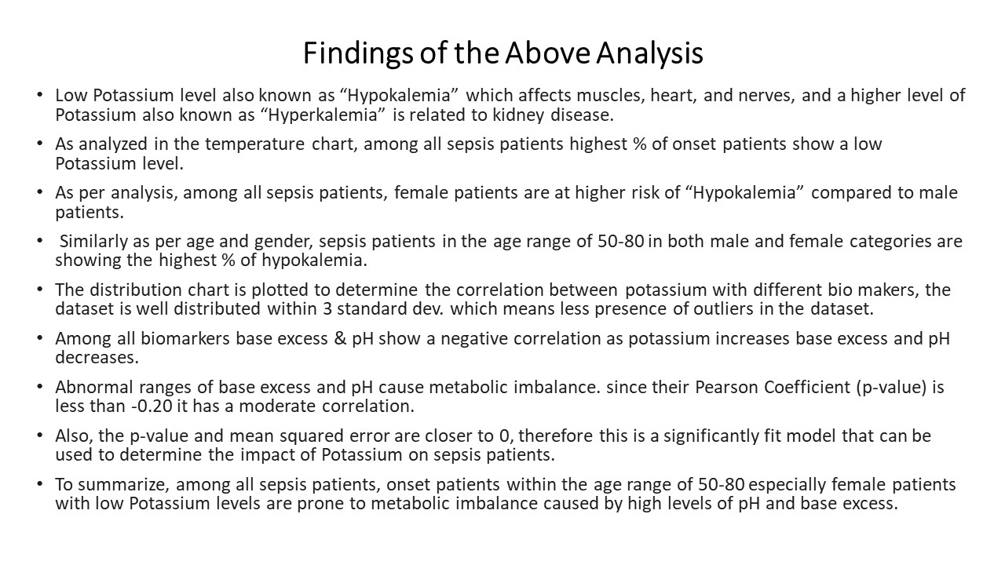

Slide 8
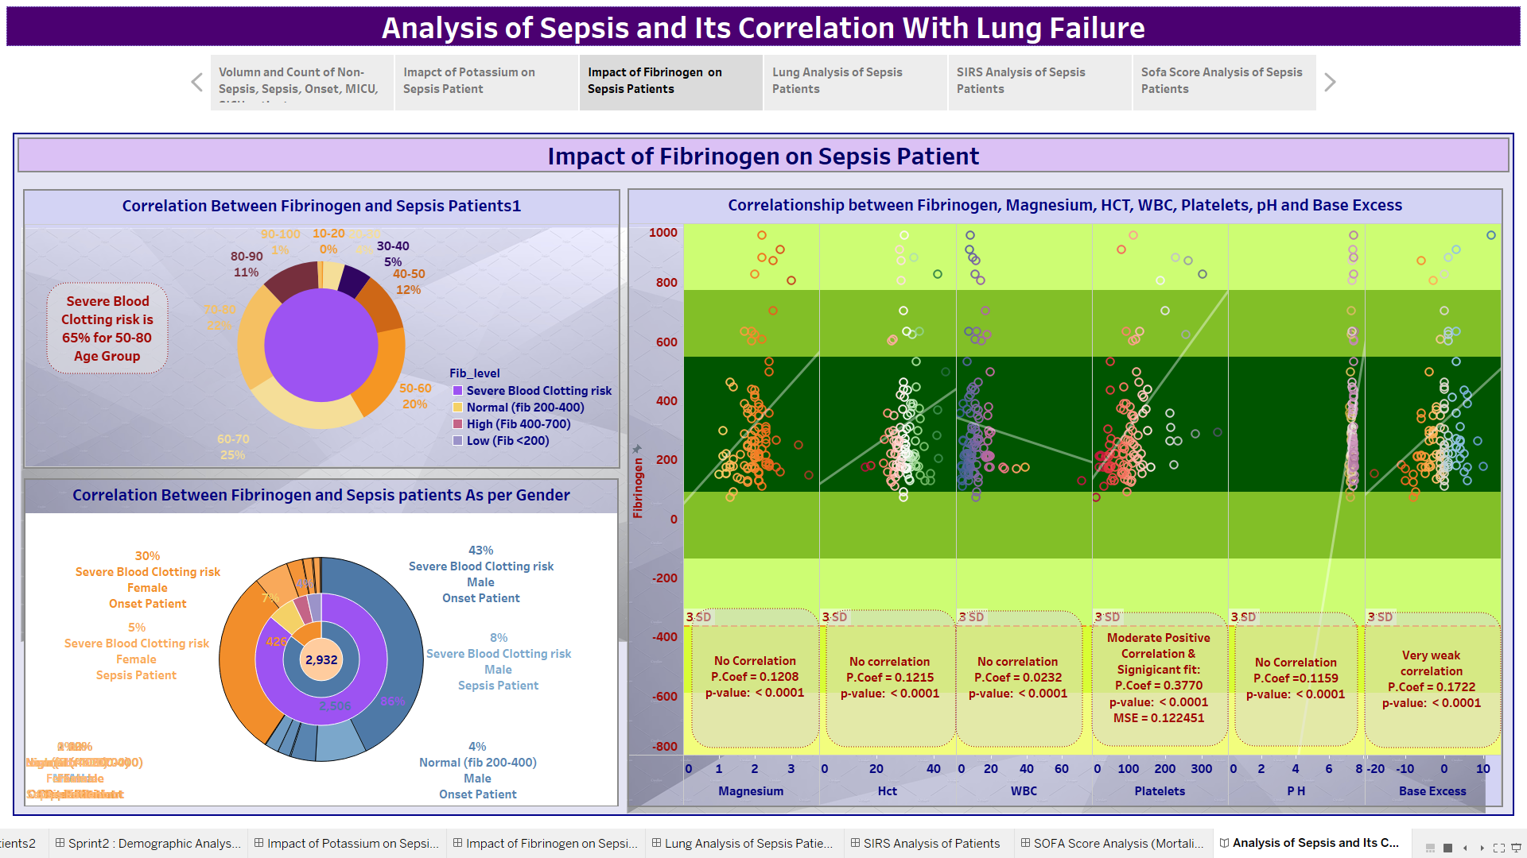

Slide 9
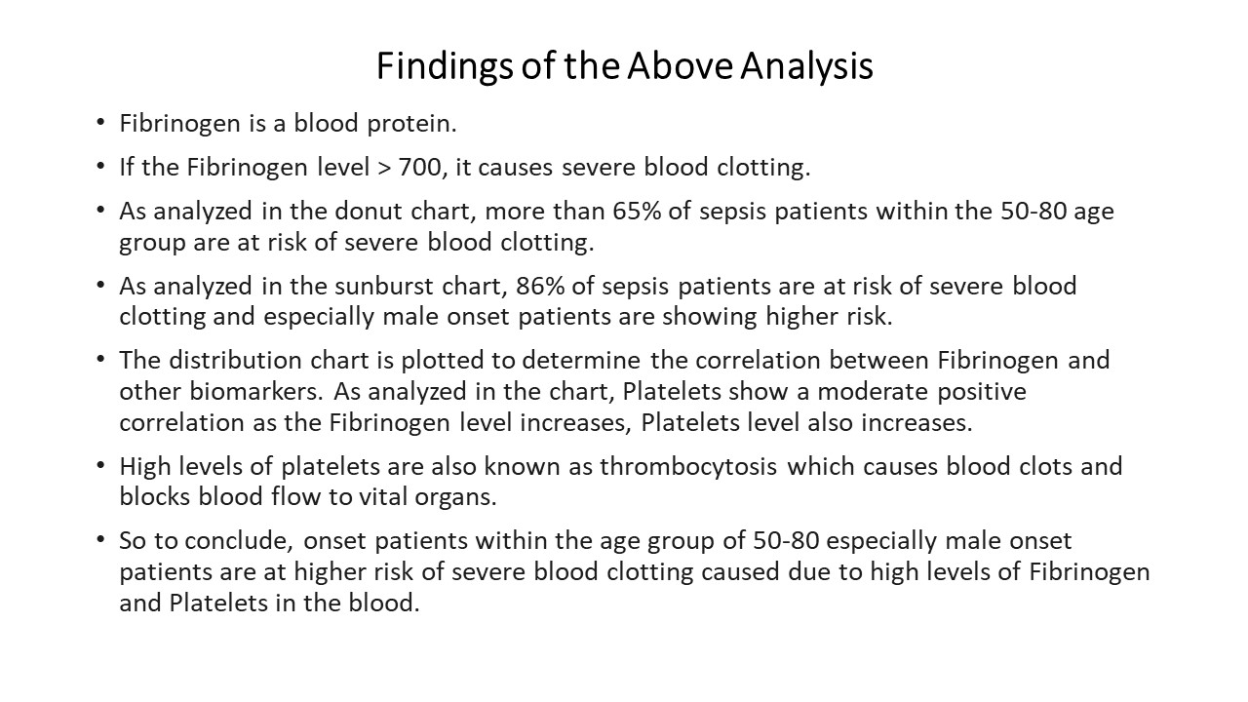

Slide 10
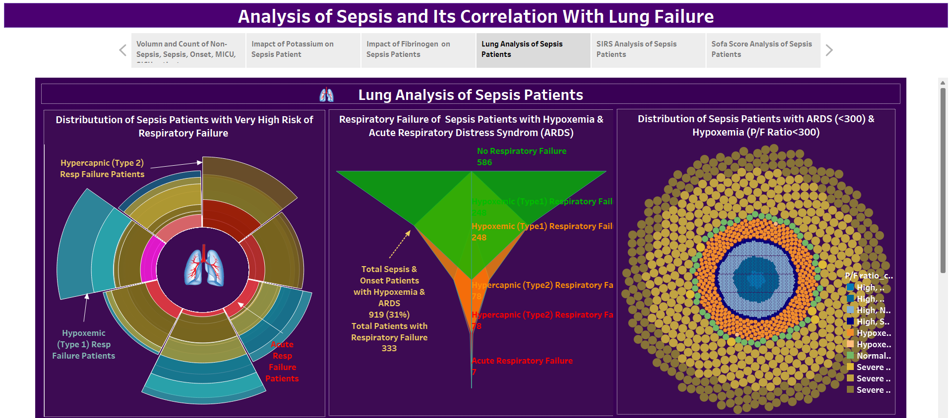

Slide 11
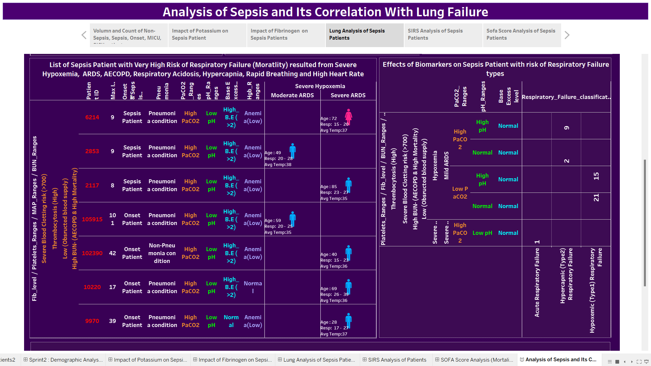

Slide 12
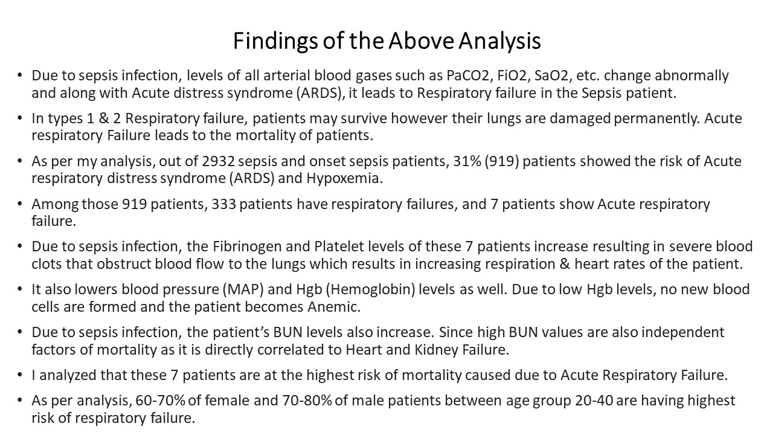

Slide 13
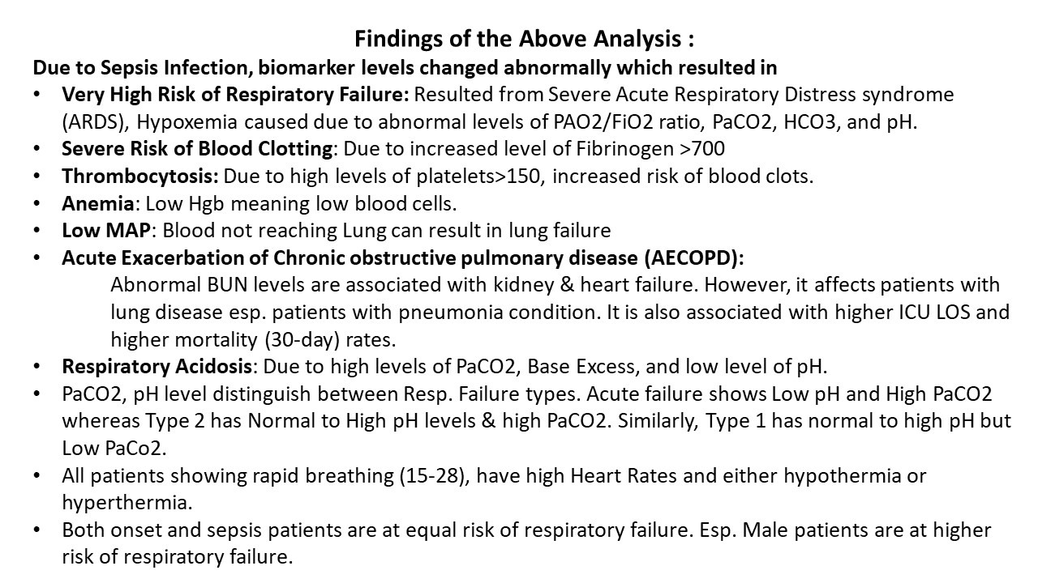

Slide 14
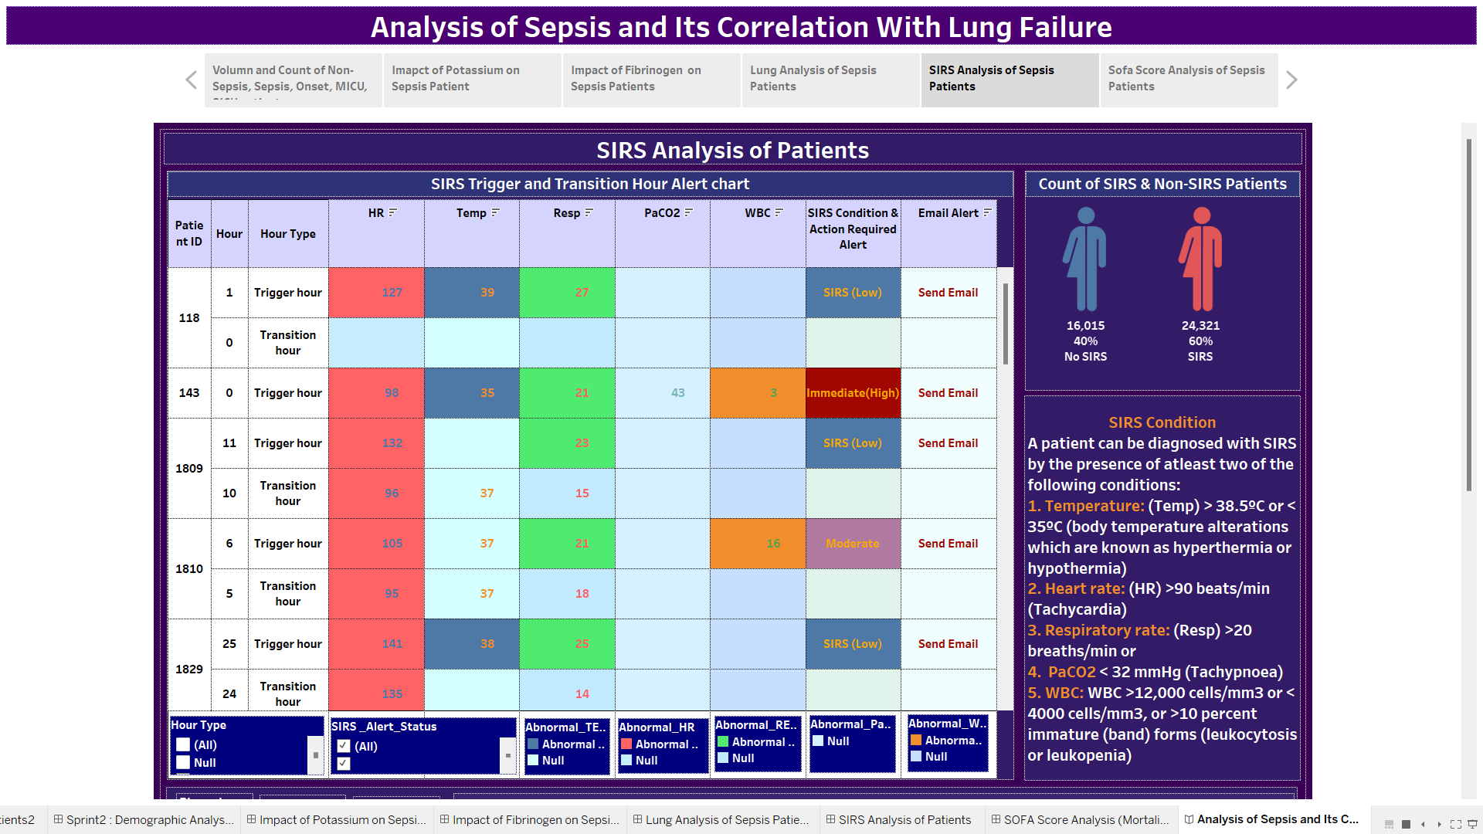

Slide 15
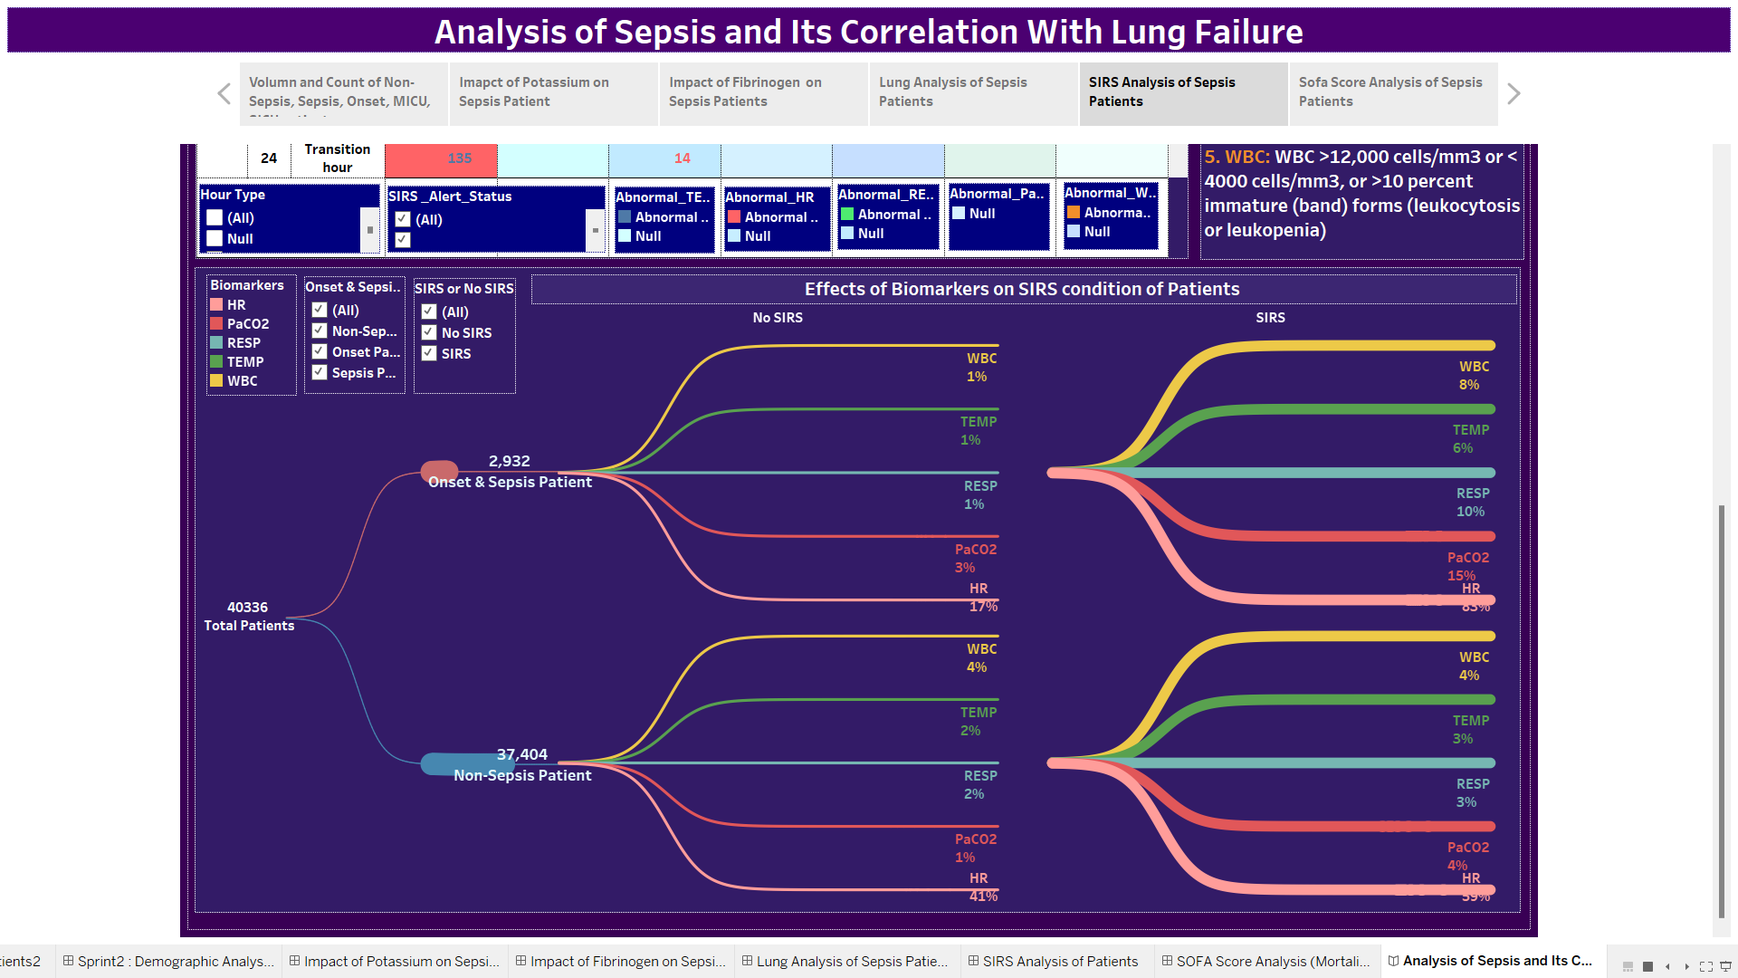

Slide 16
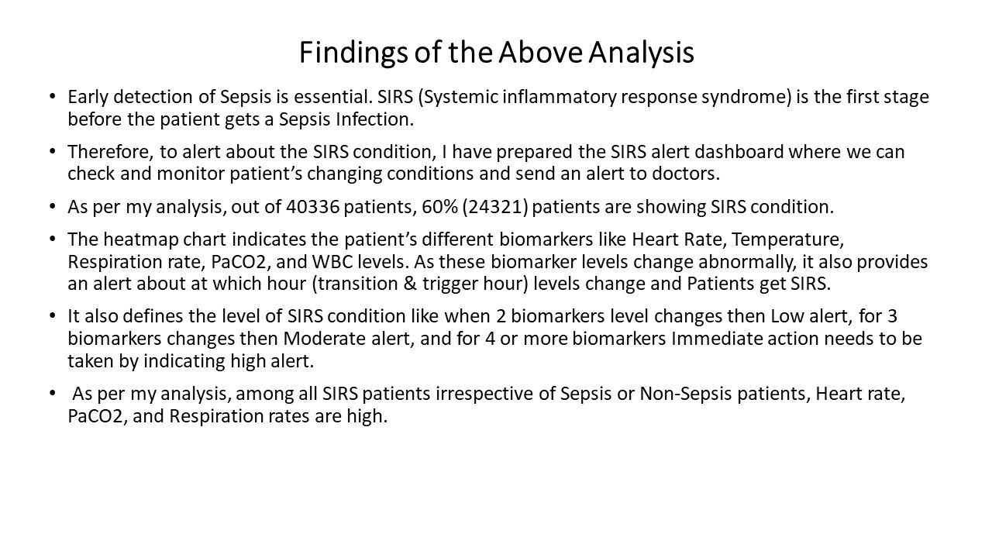

Slide 17
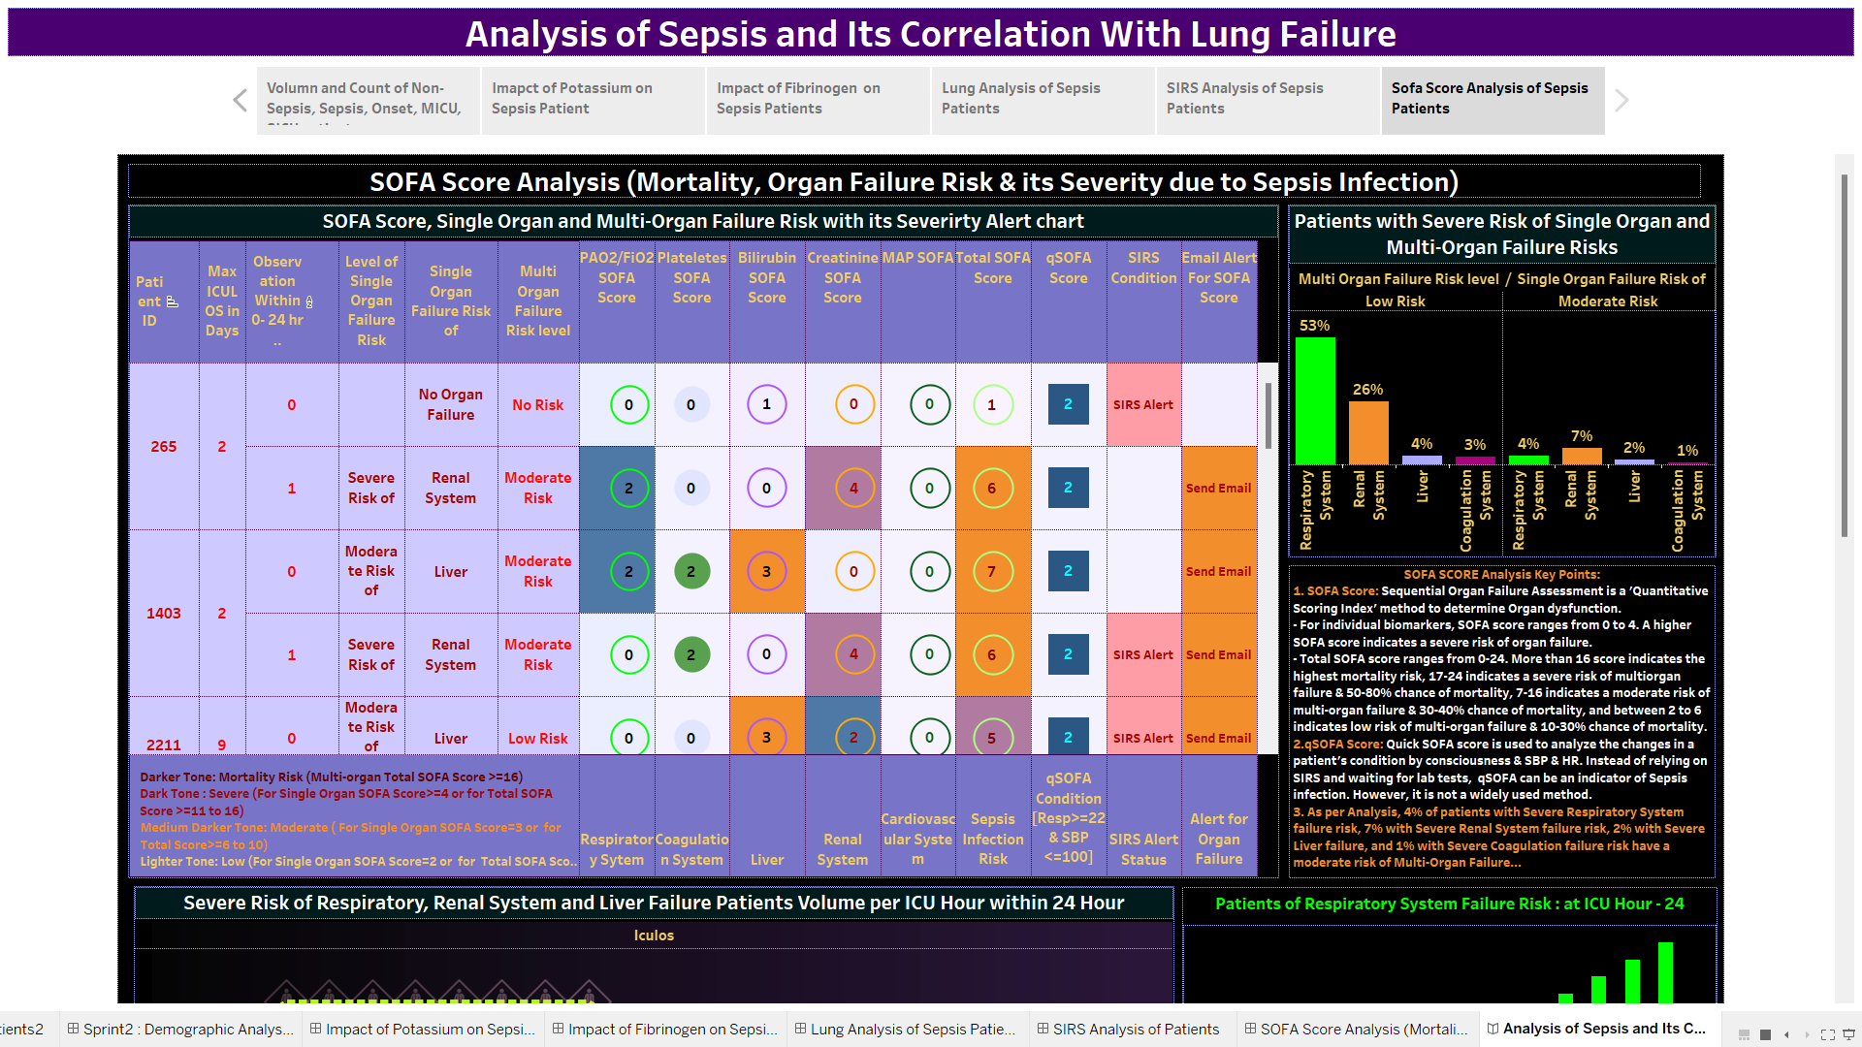

Slide 18
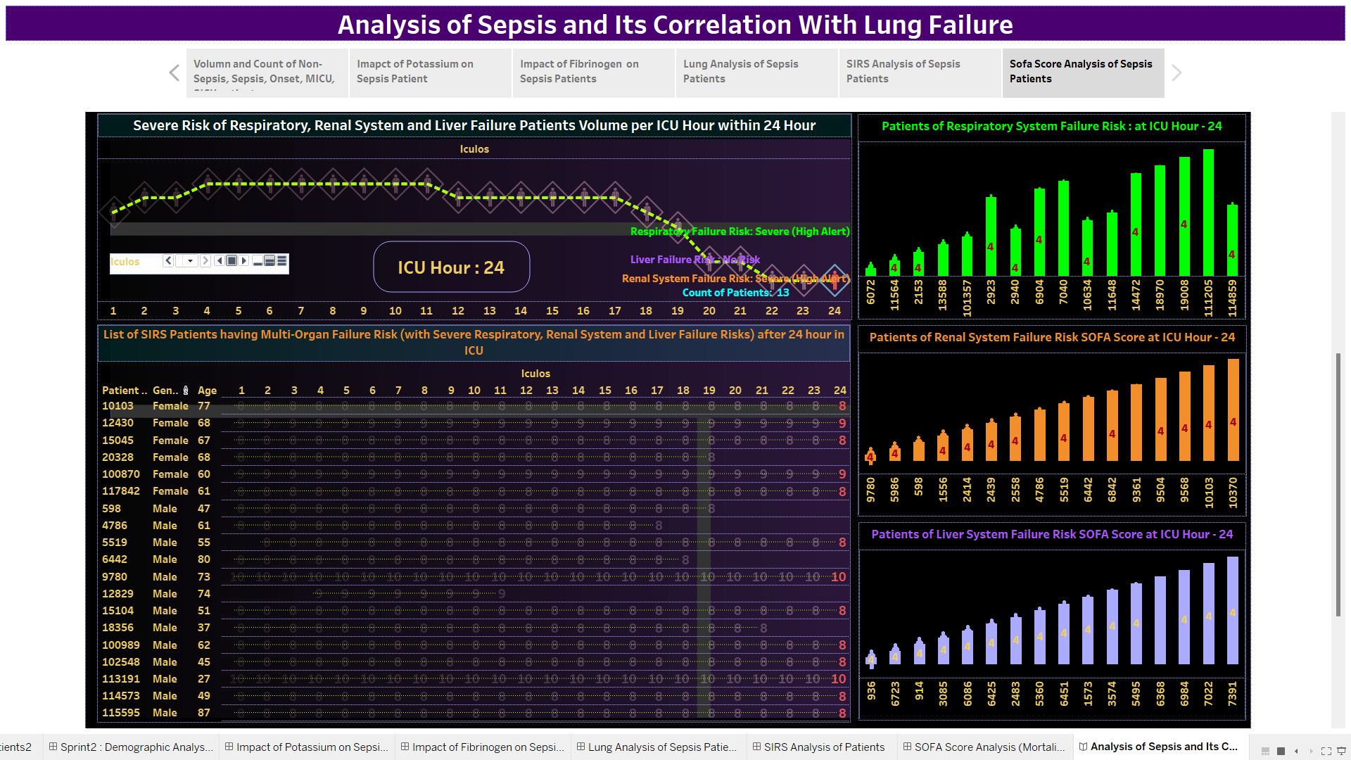

Slide 19
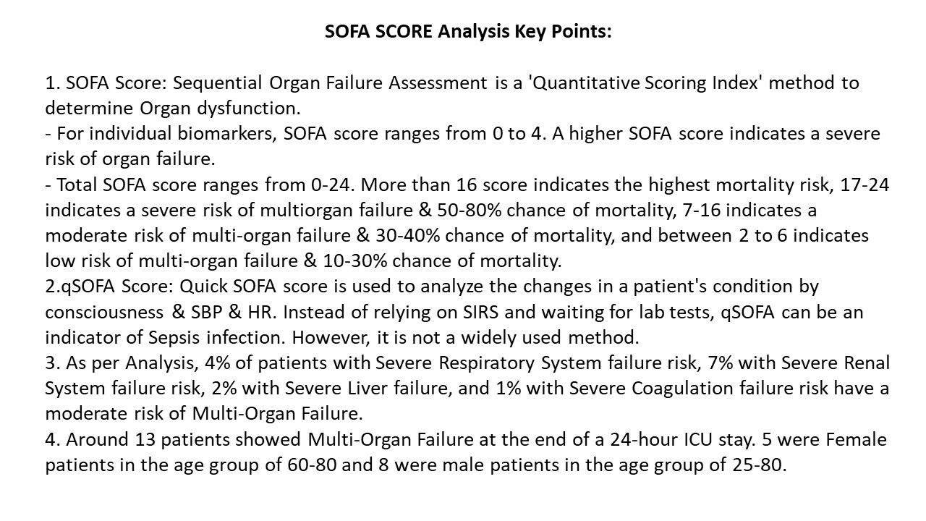

Slide 20
References
https://www.ncbi.nlm.nih.gov/pmc/articles/PMC6913810/
https://physionet.org/content/challenge-2019/1.0.0/
https://www.frontiersin.org/research-topics/56796/biomarkers-of-sepsis
https://biodatamining.biomedcentral.com/articles/10.1186/s13040-021-00235-0
https://healthmanagement.org/c/icu/issuearticle/sepsis-in-critical-care-3
https://www.verywellhealth.com/hospital-floors-and-units-3156895#toc-sicu
https://www.ncbi.nlm.nih.gov/pmc/articles/PMC6913810/#:~:text=Consequently%2C%20patients%20with%20sepsis%20might,nervous%20system%2C%20and%20hematologic%20system.
https://www.ncbi.nlm.nih.gov/pmc/articles/PMC5709181/
https://link.springer.com/article/10.1007/s001340050041
https://www.ncbi.nlm.nih.gov/pmc/articles/PMC7143675/#:~:text=Sepsis%20covers%20a%20wide%20range,according%20to%20the%20patient%20population
https://www.ncbi.nlm.nih.gov/pmc/articles/PMC8116088/
Acute respiratory distress syndrome: the Berlin Definition - PubMed (nih.gov)

Slide 21
References
https://www.healthline.com/health/fibrinogen
https://www.webmd.com/a-to-z-guides/what-is-fibrinogen-blood-test
https://www.ncbi.nlm.nih.gov/books/NBK470284/#:~:text=Sepsis%20or%20dehydration%20may%20lead,acidosis%20with%20subsequent%20potassium%20elevation
https://www.ncbi.nlm.nih.gov/pmc/articles/PMC7024748/
https://www.ncbi.nlm.nih.gov/pmc/articles/PMC7845078/
https://www.ncbi.nlm.nih.gov/pmc/articles/PMC7845078/
https://www.ncbi.nlm.nih.gov/pmc/articles/PMC8534992/
https://ccforum.biomedcentral.com/articles/10.1186/cc14095#:~:text=Patients%20with%20sepsis%2C%20who%20require,campaign%20was%20initiated%20in%202002
https://www.enherts-tr.nhs.uk/wp-content/uploads/2019/10/Post-operative-sepsis-leaflet-SAU-Final-web-1.pdf
https://www.ncbi.nlm.nih.gov/pmc/articles/PMC8116088/#:~:text=We%20found%20that%20one%2Dthird,duration%20of%20management%2015.8%20days
https://geekymedics.com/abg-interpretation/

